Slide 1
DeFyn
DeFi Portfolio Manager (Web 3.0)

Slide 2
P.S.N.A. COLLEGE OF ENGINEERING & TECHNOLOGY, DINDIGUL
Department of Computer Science and Engineering
Project 1st Review
Project Title : DeFyn - DeFi Portfolio Manager
Section : CSE-B
Domain : Web 3.0 (Block Chain , Decentralized Finance)
Batch No : 01
Team Members : Aathi Abhishek T (921318104002)
Akash Perumal G B (921318104005)
Akshay Kumar G (921318104006)
Ganesh Karuppasamy R (921318104044)
Internal Guide Name : D.Suresh M.E., Ph.D.

Slide 3
ABSTRACT:
Problem Statement :
The motive of the project is to develop a dApp - DeFi (Decentralized Finance) for transferring, receiving, managing crypto assets. As crypto is going to be the future of currency we need a system which is similar to existing bank.
Problem description :
“Change is constant ” and its obvious. We had barter system which turned into monetary system with time, which later evolved into digital currencies like CBDC - [Central Bank Digital Currency], Decentralised assets like Bitcoin, Ether, Matic and the list goes on.
We have internet banking, mobile banking to manage our money and transactions but we only have prominent apps to transfer decentralised digital assets and not for managing them. Certain apps are in the market which are not user friendly for rookies.
So with our app we try to make users a smooth transition from web 2.0 to web 3.0.

Slide 4
EXISTING SYSTEM:
DeBank, Zerion are the top defi portfolio manager apps available in the market at present.
Problems in the exisitng system:
Only wallet authentication is available for Signup/Login users. This makes hard for the users to sign in to other devices and view their data.
Once the private key is lost, no one can view the history in those apps.
Only shows the public addresses of sender and receiver in the statement which then becomes tedious for accounting.
Sometimes Zerion shows the activity even after disconnecting. [ privacy left the chat ;( ]

Slide 5

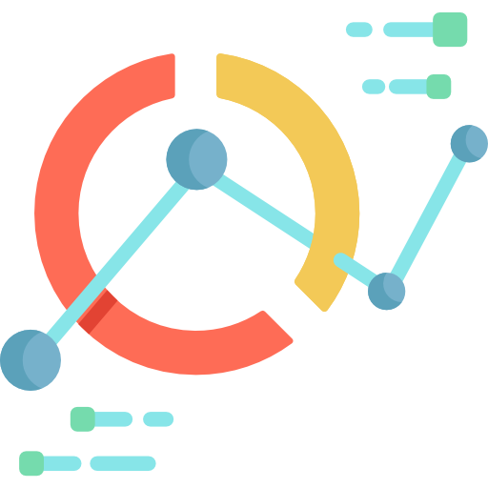
PROPOSED SYSTEM:
Our DeFyn app has the following merits over the other apps present:
Use of both email, password and wallet for authentication.
Wallet spoof proof.
Analytics dashboard (Tokens, expenditures with category and much more).
Download reports (History of transactions, Mini statement).
Options to add friend, block and share only the address of your choice to your friends. This is something fun like internet banking app having power of facebook’s friend request model.

Slide 6
LITERATURE SURVEY:
Reference Link | Title | Year | Author | Purpose
https://ieeexplore.ieee.org/document/9150192 | The Decentralized Financial Crisis | 28 July 2020 | Lewis Gudgeon, Daniel Perez, Dominik Harz, Benjamin Livshits, Arthur Gervais | DeFi or Decentralized Finance is a new type of financial application that does not require an intermediary. Banks or financial institutions. DeFi is built on Blockchain technology that stores DeFi transaction data or “decentralized finance” and aims to create financial services that are open to all.
https://ieeexplore.ieee.org/document/9720373 | Financial Technology DeFi Protocol: A Review | 04 March 2022 | Chaimade Busayatananphon, Ekkarat Boonchieng
https://ieeexplore.ieee.org/document/9752657 | Decentralized finance (DeFi): The Future of Finance and Defi Application for Ethereum blockchain based Finance Market | 15 April 2022 | B. Sriman, S. Ganesh Kumar

Slide 7
HARDWARE AND SOFTWARE REQUIREMENTS:
Hardware:
Processor : i3 processor and above.
RAM : 4 GB and above
Storage : 3 GB or more (Browser and misc..)
Internet Bandwidth : At least 5 Mbps
Software:
OS : Windows 10 and above, Mac OS X Big Sur and above, Linux - any distro with latest web browser.
Web Browser : Google Chrome, MS Edge, Apple Safari, Firefox, Brave.
Extensions : Meta Mask web extension. (Software Private Wallet).
Mobile app : Meta Mask for Android / iOS (Latest version)

Slide 8










Technology Stack :
Frontend Backend Tools
Node Package Manager
Moralis Serverless - Cloud Functions
Web3 JS

Slide 9
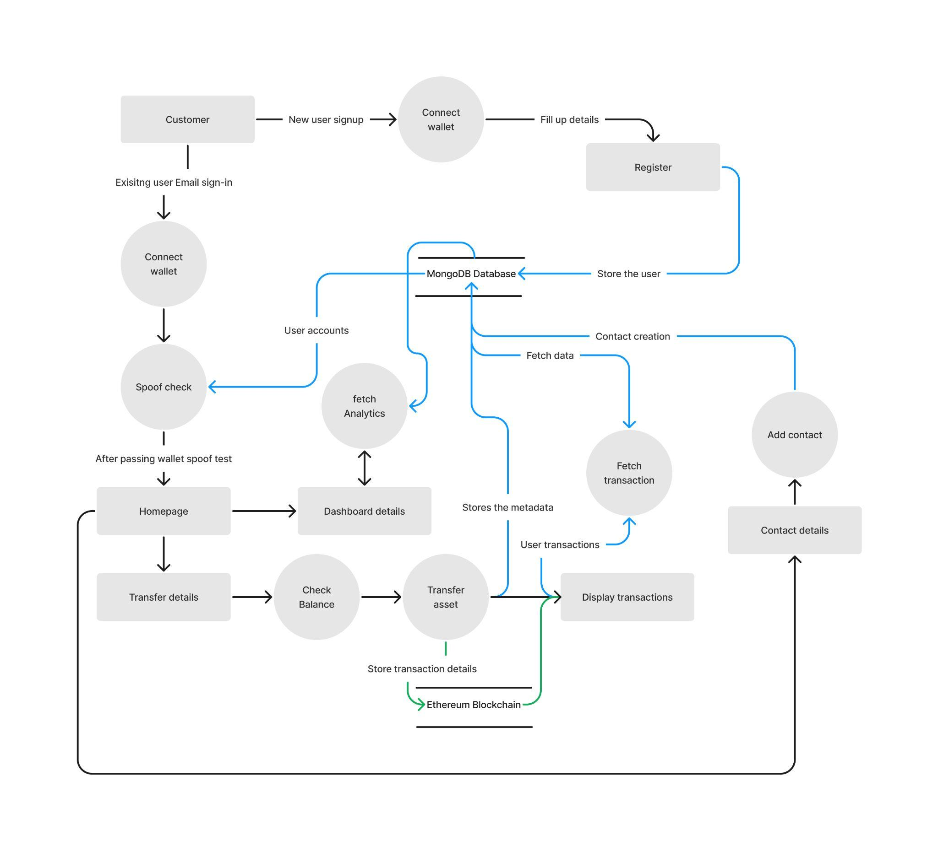
LOW LEVEL DESIGN : (Data Flow Diagram)

Slide 10
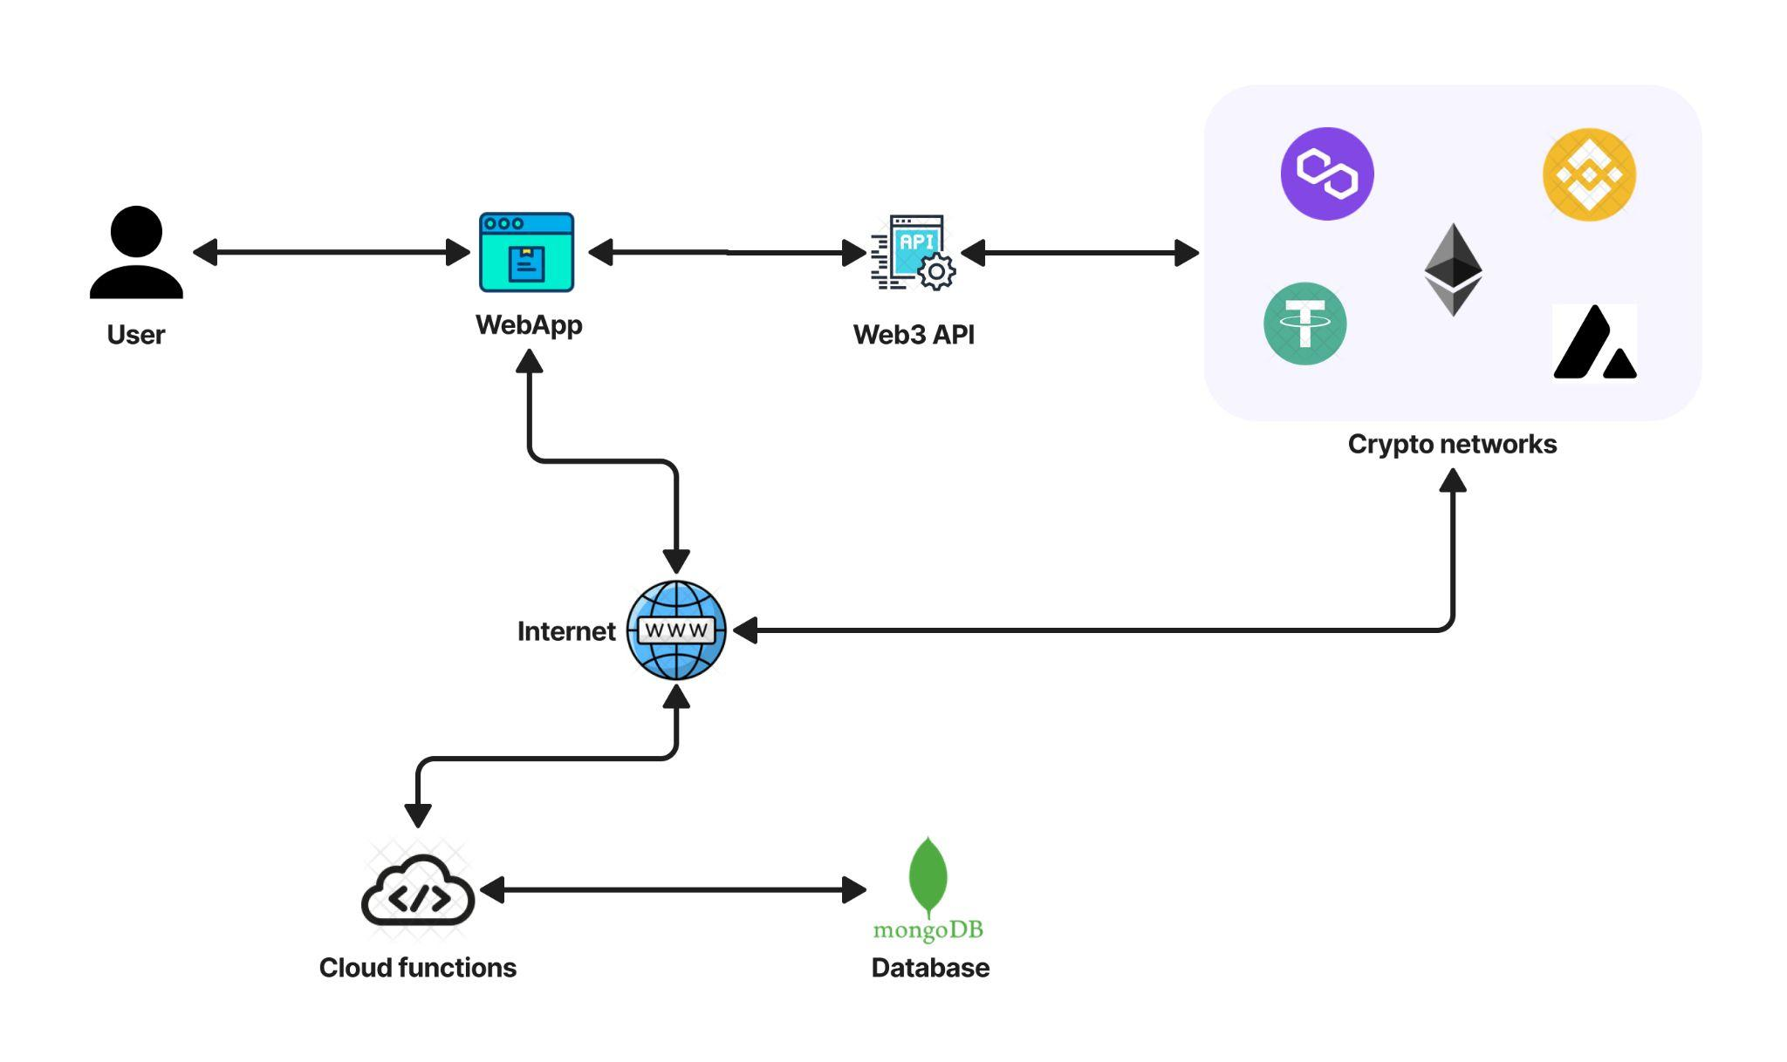
HIGH LEVEL DESIGN:

Slide 11
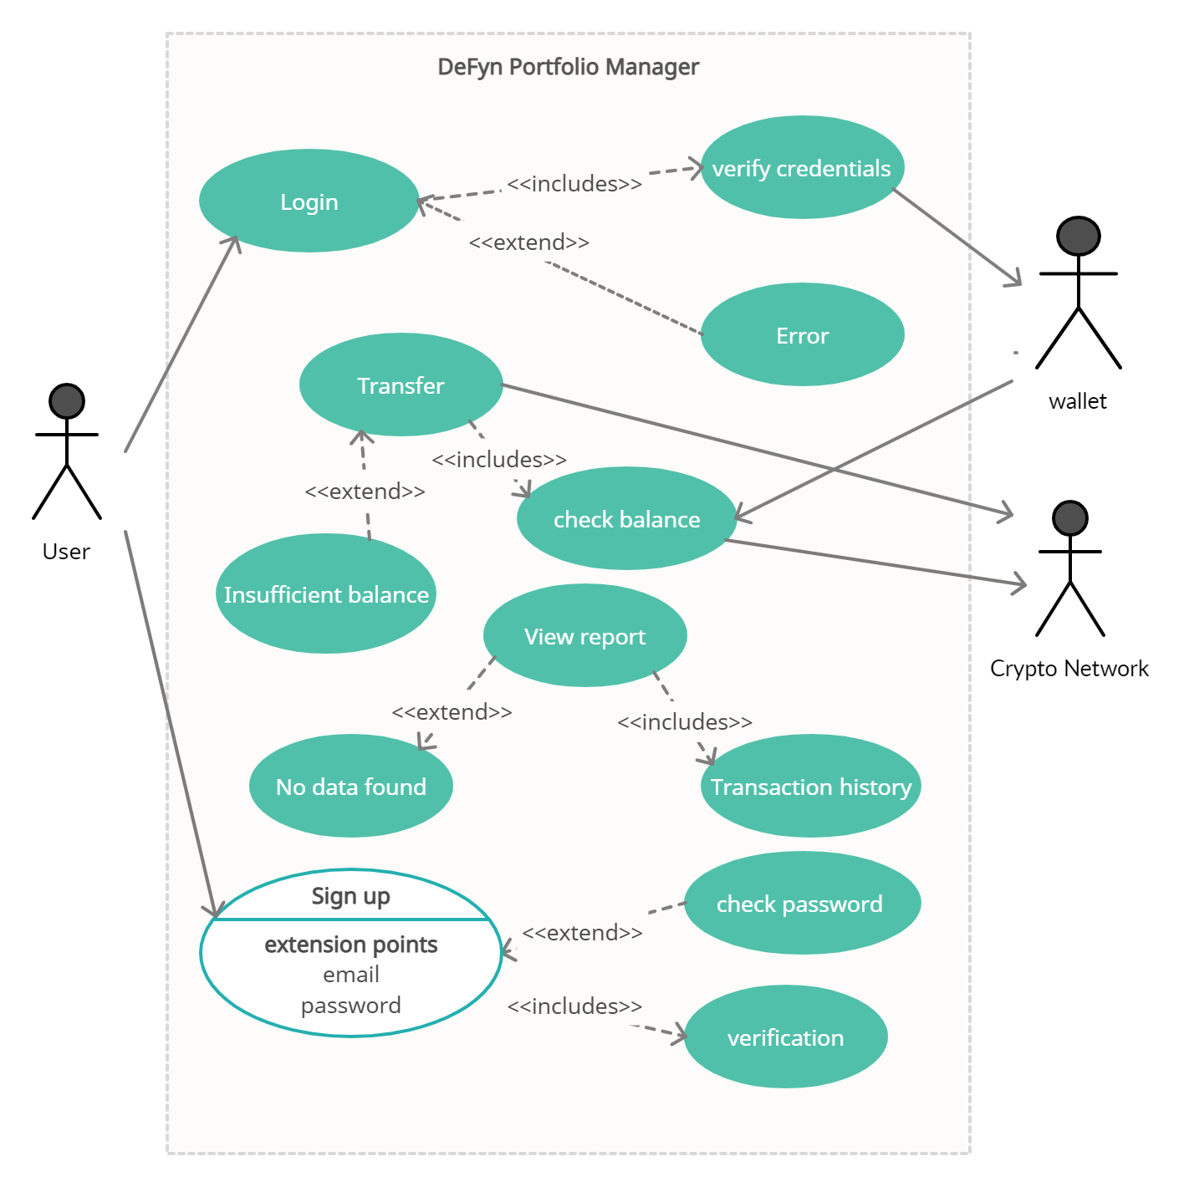
UML DIAGRAMS: (Use case, Activity, sequence)

Slide 12
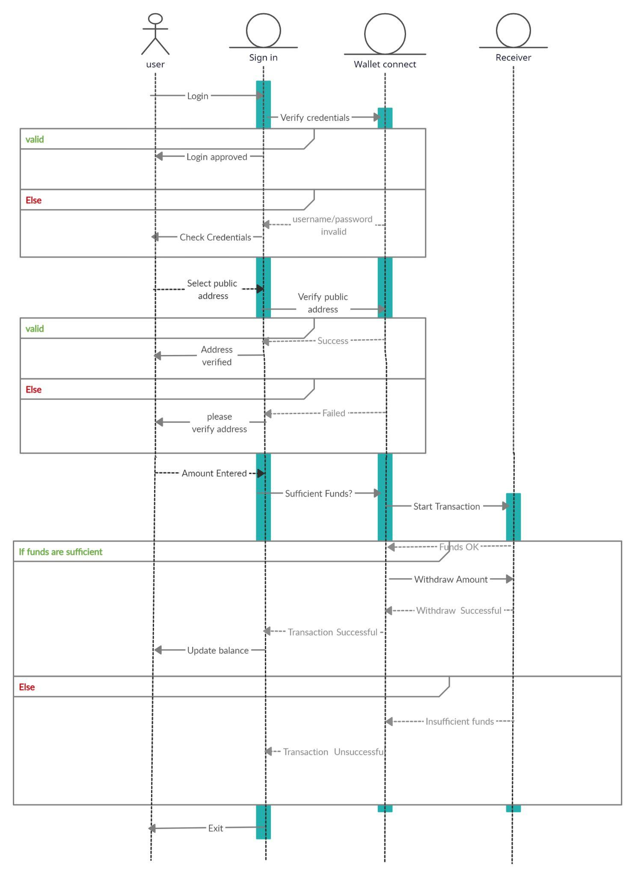

Slide 13
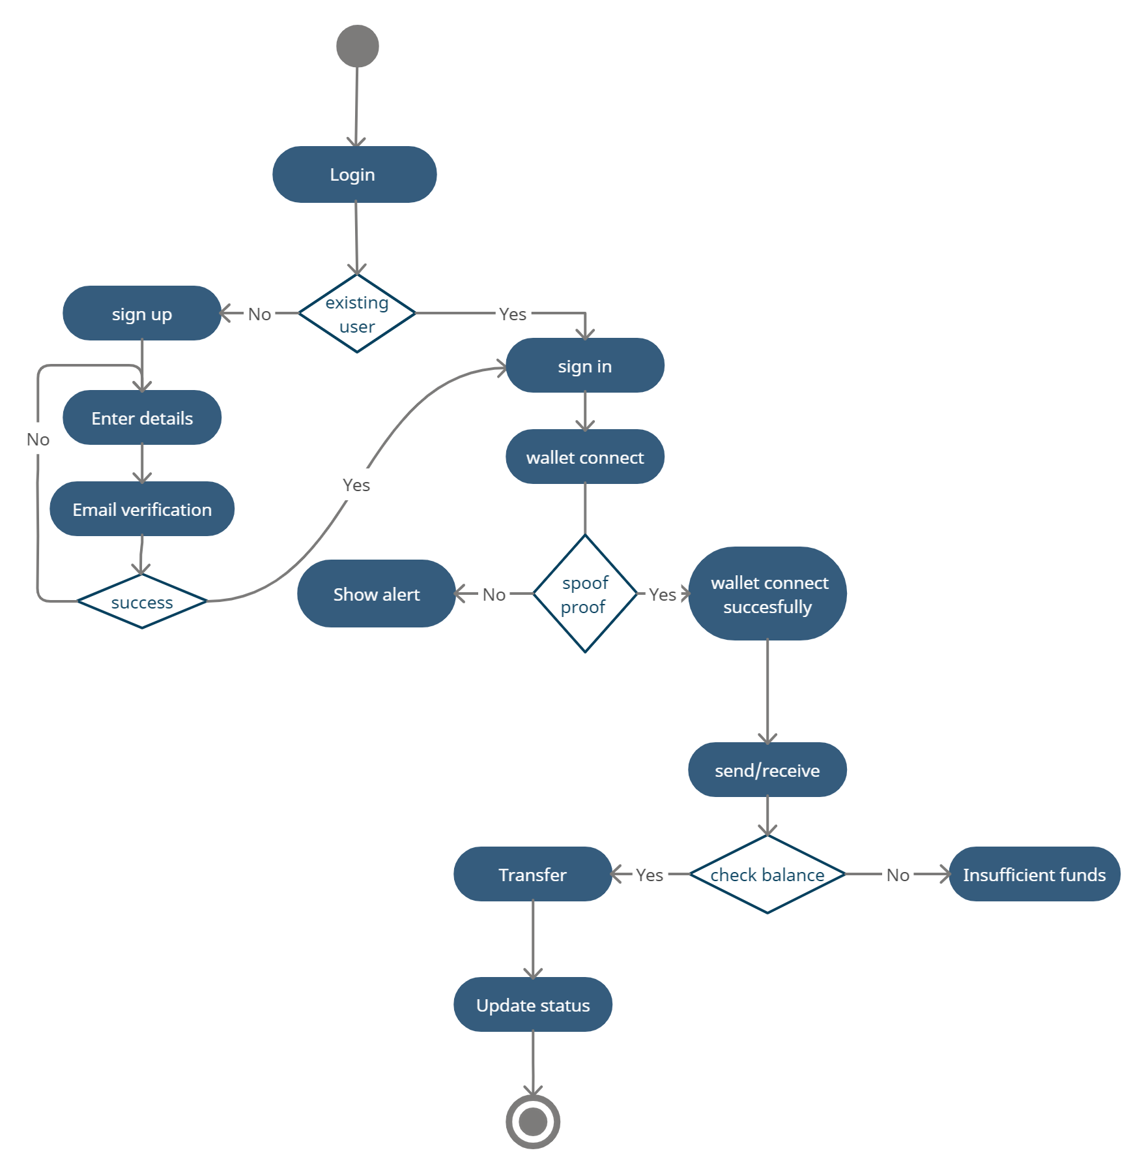

Slide 14
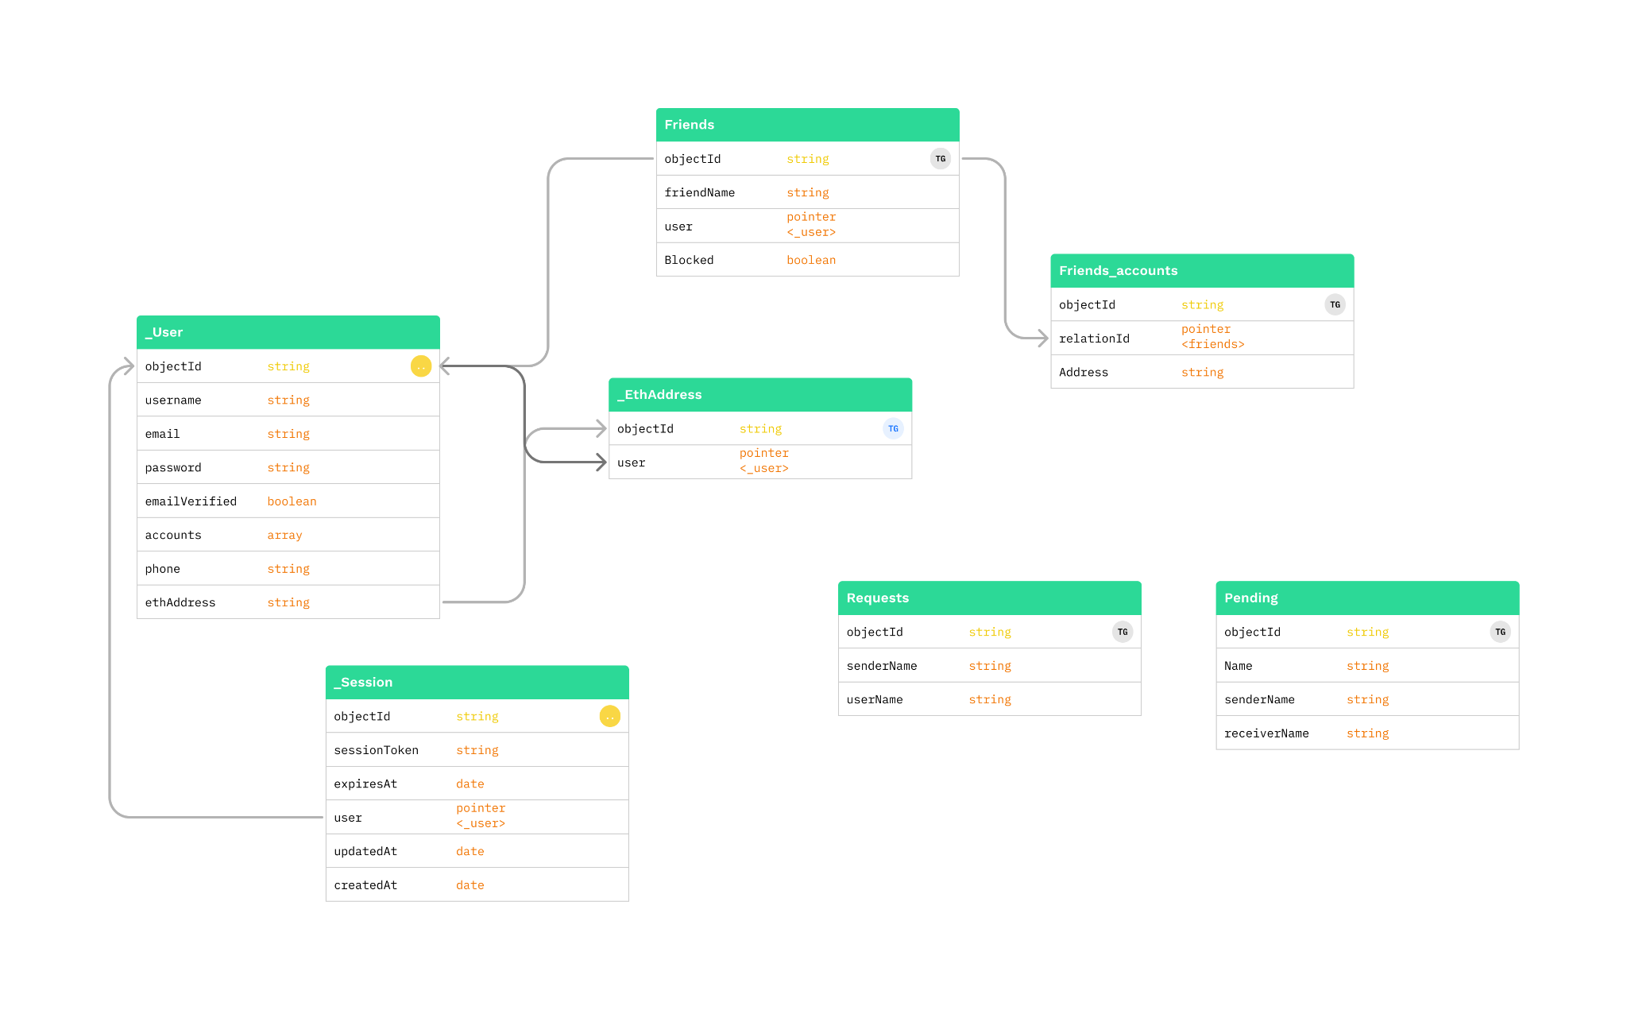
DATABASE DESIGN:

Slide 15
MODULES:
Module 0: Designing UI (User Interface)
This is to design low, mid and high fidelity wireframes i.e conceptualizing the final output by using figma.
Various app screens are designed.
Module 1: Authentication
In this module the user can sign in or sign up to the application by use of registered email and password. Each user has to sign in to their wallet to perform operations such as (transaction , history, status) etc.
The wallet set up needs the password and private address only for the first time or when the wallet is set up in the new device.
Module 2: Friends - contacts creation, edit, block, delete.
This module the user can send request to other users which is similar to Instagram, facebook friend request and in return they receive public address and thus contact gets created. Here if one user request address and the other user accepts the request, then both the parties gets their public addresses exchanged.

Slide 16
MODULES:
Module 3: Dashboard
This modules shows the analytics section of the app, such as representing data in a graph, pie charts etc. Data such as number of transactions, expenditure category, most used tokens and much more.
Module 4: Transfer
In this module the user can perform operation like transfer (credit or debit) the coins from one person (sender) to another (receiver) by using their public address, which is already in the contact/friend list.After the transaction we can able to see status of the transaction i.e. whether the transaction is completed or pending.
Module 5: History of transactions
This module is the user can view their past transactions and can also download them at the same time. Details such as Sender name, receiver name, amount, network, gas fees, purpose, description etc. are shown here. It is used for the future reference for the user in order to check for what they spend the coins.

Slide 17
References:
DeFi portfolio managers:
Zerion: https://zerion.io/
DeBank: https://debank.com/
HDFC Internet banking : https://netbanking.hdfcbank.com/netbanking/
Stackoverflow : https://stackoverflow.com/
The Decentralized Financial Crisis (28 July 2020) :
https://ieeexplore.ieee.org/document/9150192
Financial Technology DeFi Protocol: Review(04 March 2022)
https://ieeexplore.ieee.org/document/9720373
A Decentralized finance (DeFi): The Future of Finance and Defi Application for Ethereum blockchain based Finance Market(15 April 2022):
https://ieeexplore.ieee.org/document/9752657

